Slide 1
MULTIMODALITY
Theory of communication: using multiple modes – textual, aural, linguistic, visual – to compose, to create a single artifact

Slide 2
MULTIMODAL TEXTS
Texts which communicate their message using more than one semiotic mode, or channel of communication.
Examples: magazine articles (words and pictures), or websites (audio clips alongside the words), or film (words, music, sound effects and moving images).

Slide 3
MODE
Gunther Kress, a composition scholar, writes that a mode “is a socially and culturally shaped resource for making meaning. Image, writing, layout, speech, moving images are examples of different modes.” Kress continues: “mode is meaningful: it is shaped by and carries the ‘deep’ ontological and historical/social orientations of a society and its cultures with it into every sign. Mode names the material resources shaped in often long histories of social endeavor.”

Slide 4
MEDIUM
Medium is the substance in which meaning is realized and through which it becomes available to others. Mediums include video, image, text, audio, etc.

Slide 5
SOCIAL MEDIA
Facebook
Twitter
Instagram
Blogging
Snapchat
Are these multimodal? If so, how – what makes them multimodal? What are the affordances of these devices?

Slide 6
MEMES
A meme acts as a unit for carrying cultural ideas, symbols, or practices that can be transmitted from one mind to another through writing, speech, gestures, rituals, or other imitable phenomena with a mimicked theme.
Are memes multimodal? If so, how?

Slide 7
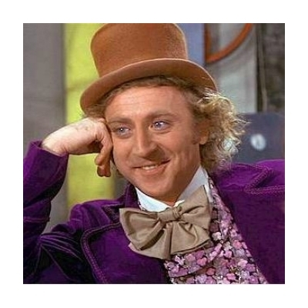
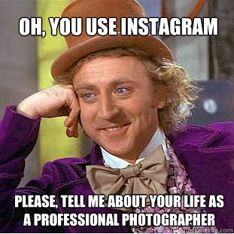
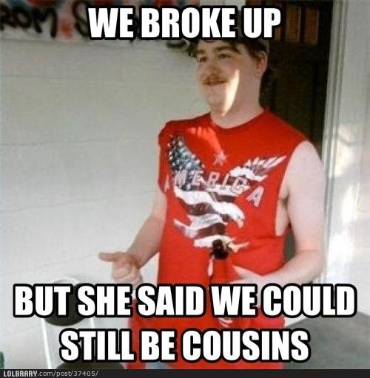
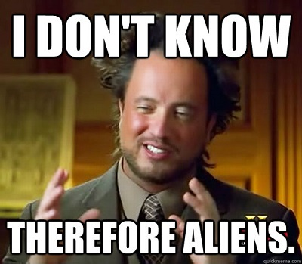

Slide 8
QUESTIONS
What multimodal device do you use the most?
Why do you think we’re attracted to multimodality?
How has technology increased and embraced multimodality?
How are children’s books multimodal?
What are the different mediums you’re going to use?
Go ahead and think about your process. Map out a schedule.

Slide 9
RESOURCES
Jody Shipka, A Composition Made Whole
Anne Wysocki, Writing New Media: Theory and Applications for Expanding the Teaching of Composition
Claire Lutkewitte, Multimodal Composition: A Critical Sourcebook
http://ccdigitalpress.org/dwae/
https://multimodalityglossary.wordpress.com/multimodality/

Slide 10
DIGITAL RHETORIC
Digital rhetoric is the art of informing, persuading, and inspiring action in an audience through media.

