Slide 1
IMAGE ANALYSIS

Slide 3
Lebron james
Context
LeBron James announced he was “coming back home” to Cleveland in July 2014
LeBron James was drafted by the Cleveland Cavaliers with the #1 pick in 2003 and played for them from 2003-2010 before going to the Miami Heat
The Cleveland Cavaliers have never won an NBA championship
This banner will on a ten story building and will span 25,000 square feet
LeBron had a banner similar to this when playing for Cleveland that read “We Are All Witnesses”
LeBron wore #23 in Cleveland and wore #6 in Miami. LeBron announced via Instagram that he was going back to #23
LeBron was born and raised in Ohio
LeBron is (arguably) the greatest basketball player in the world

Slide 5
THE BEATLES
Context
The Beatles album cover for Abbey Road (1969)
Abbey Road was the 11th studio album for The Beatles
Abbey Road was the second to last album recorded by The Beatles
Picture is taken outside the Abbey Road Studios
Abbey Road is the Beatles’ best-selling album
Cover designed by Apple Records
Only original UK Beatles sleeve to not show the album title and band name
McCartney is barefoot and out of step with the other band members
Harrison is the only one not wearing a suit
One of the most famous imitated photographs across the world

Slide 7
TIGER WOODS
Context
Released in 2010 after the Tiger Woods extramarital affair controversy
What assumptions and stereotypes are being made about this image?
How was Tiger Woods displayed before the controversy?
How is his image being displayed on this cover?

Slide 9
Muhammad ali
Context
Muhammad Ali vs. Sonny Liston (1965)
Sports Illustrated notes this as the fourth greatest sports moment of the 20th century
Ali-Liston fought twice: 1964 & 1965
First fight Muhammad Ali’s name was still “Cassius Clay”
Liston was the Heavyweight Champion at the time of the first fight
“Beginning” of mainstream Ali recognition
Ali won both fights

Slide 11
Apollo 11
Context
Photograph taken by Neil Armstrong (1969)
Astronaut Bill Aldrin walking along the moon
Neil A. Armstrong, Michael Collins, and Edwin E. "Buzz" Aldrin, Jr. were the first people on the moon
Apollo 11 – spaceflight
Mission duration: 8 days 3 hours 13 minutes

Slide 12
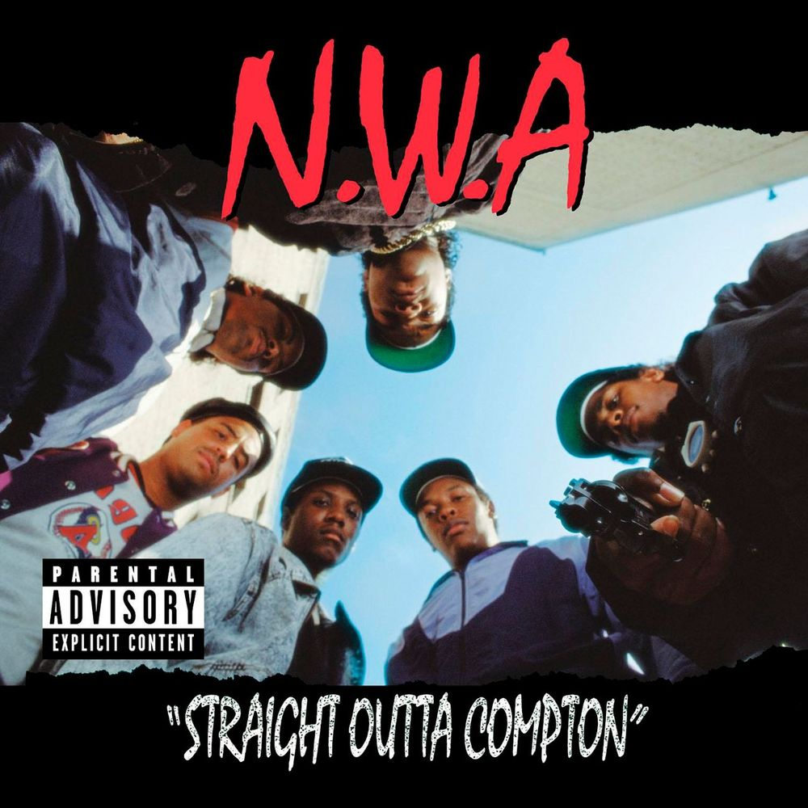

Slide 13
N.W.A
Context
Considered the beginning of West Coast “gangsta” rap
Hailing from Compton, Ca.
Explicit lyrics: disrespecting women, glorifying drugs and crime, hatred for police
Banned from mainstream American radio
Compton (mid to late-80s): hyper gang violence

