Slide 1
ANALYZING VISUAL RHETORIC

Slide 3
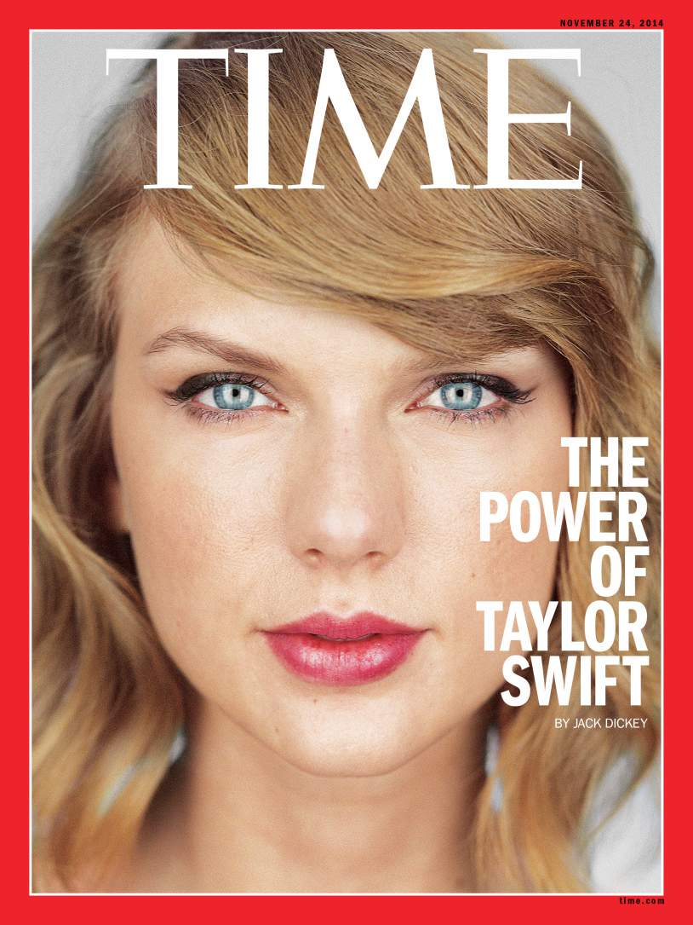

Slide 4
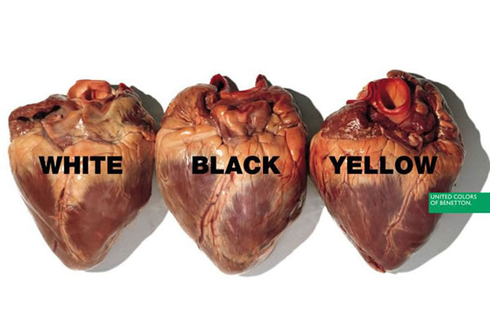

Slide 5
